Slide 1
Java Strings
Strings are used for storing text.
A String variable contains a collection of characters surrounded by double quotes:
Example
Create a variable of type String and assign it a value:
String greeting = "Hello";

Slide 2
String Length
A String in Java is actually an object, which contain methods that can perform certain operations on strings. For example, the length of a string can be found with the length() method:
Example
String txt = "ABCDEFGHIJKLMNOPQRSTUVWXYZ";
System.out.println("The length of the txt string is: " + txt.length());

Slide 3
More String Methods
There are many string methods available, for example toUpperCase() and toLowerCase():
Example
String txt = "Hello World";
System.out.println(txt.toUpperCase()); // Outputs "HELLO WORLD"
System.out.println(txt.toLowerCase()); // Outputs "hello world"

Slide 4
Finding a Character in a String
The indexOf() method returns the index (the position) of the first occurrence of a specified text in a string (including whitespace):
Example
String txt = "Please locate where 'locate' occurs!";
System.out.println(txt.indexOf("locate")); // Outputs 7

Slide 5
String Concatenation
The + operator can be used between strings to combine them. This is called concatenation:
Example
String firstName = "John";
String lastName = "Doe";
System.out.println(firstName + " " + lastName);

Slide 6
You can also use the concat() method to concatenate two strings:
Example
String firstName = "John ";
String lastName = "Doe";
System.out.println(firstName.concat(lastName));

Slide 7

Special Characters
Because strings must be written within quotes, Java will misunderstand this string, and generate an error:
String txt = "We are the so-called "Vikings" from the north.";
The solution to avoid this problem, is to use the backslash escape character.
The backslash (\) escape character turns special characters into string characters:

Slide 8
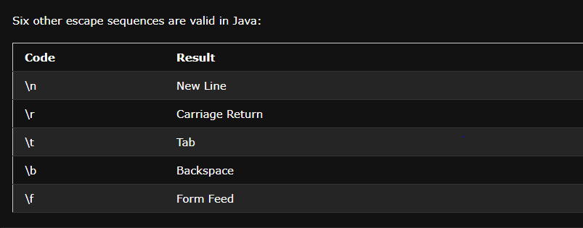

Slide 9
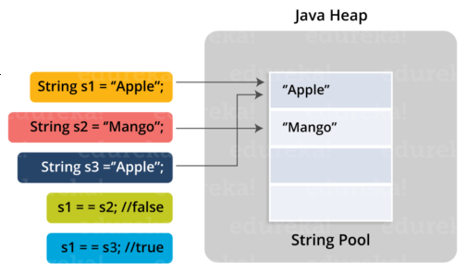
String Pool

Slide 10
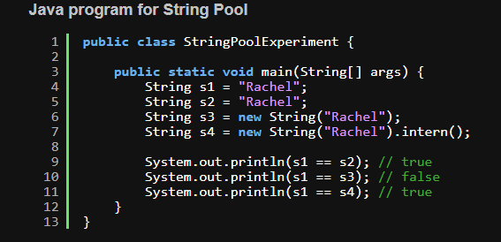

Slide 11
Java Math
The Java Math class has many methods that allows you to perform mathematical tasks on numbers.
Math.max(x,y)
The Math.max(x,y) method can be used to find the highest value of x and y:
Math.min(x,y)
The Math.min(x,y) method can be used to find the lowest value of of x and y:

Slide 12
Math.sqrt(x)
The Math.sqrt(x) method returns the square root of x:
Math.abs(x)
The Math.abs(x) method returns the absolute (positive) value of x:
Random Numbers
Math.random() returns a random number between 0.0 (inclusive), and 1.0 (exclusive):
int randomNum = (int)(Math.random() * 101); // 0 to 100

Slide 13
Java Booleans
Very often, in programming, you will need a data type that can only have one of two values, like:
YES / NO
ON / OFF
TRUE / FALSE
For this, Java has a boolean data type, which can take the values true or false.

Slide 14
Boolean Values
A boolean type is declared with the boolean keyword and can only take the values true or false:
Example
boolean isJavaFun = true;
boolean isFishTasty = false;
System.out.println(isJavaFun); // Outputs true
System.out.println(isFishTasty); // Outputs false

